Slide 1
An introduction to signaling pathways between the brain and gut

Slide 2
Overview of the video series
Introduction to video series & historical understanding of brain physiology
Overview of BBB structure & mechanisms of blood-brain barrier (BBB) transport
Introduction to the gut microbiota & how these microbes influence host health
e.g., = example
i.e., = in other words

Slide 3
Important questions that you could answer by the end of this video series
Why is the brain described as an immune-privileged organ?
What is the BBB? What are the different mechanisms that facilitate BBB transport?
What are the two primary pathways that gut microbes can communicate with the brain?
Why are gut bacteria essential for normal brain development?
Why is the vagus nerve implicated in Parkinson’s disease pathology?

Slide 4
Historical understanding of brain physiology

Slide 5
Why is historical context important?
Scientists who discovered and proposed the existence of the BBB are often misidentified
Scientists struggle to describe the mechanisms which mediate the movement of molecules from the blood to brain
i.e., the central nervous system is still described as impenetrable, despite the necessity of molecules to cross the BBB for survival
This misconception has historical roots
The mechanism utilized to cross the BBB affects tissue specificity of a drug (discussed in the second video of this series)
The idea that changes in the gut can lead to changes in the brain is very new
We are still discovering pathways of the gut-brain axis, and trying to understand the importance of the gut microbiota

Slide 6
We used to think the brain was an immune-privileged organ
It was thought the brain could only respond to sensory signals through nerves
e.g., if you stub your toe, you would feel pain because a pain signals was sent through your nerves
If you transplant foreign tissue into your body, your immune system attacks it (usually)
20th century scientists tried transplanting foreign tissue onto a brain, and observed no immune response from the brain

Slide 7
Membrane-impermeable dyes could not cross from the blood to the brain
20th century scientists injected trypan red and methylene blue into the circulatory system (Franke, 1905; Bouffard, 1906)
This caused all vascularized tissues, except the central nervous systems, to be dyed red or blue
Scientists also tried injecting trypan blue directly into the lumbar spine (Goldman, 1913)
This caused only the central nervous system to be dyed
Goldman is often referred to the originator of the BBB concept
These experiments demonstrated that some structure or process stopped the movement of dyes into the central nervous system

Slide 8
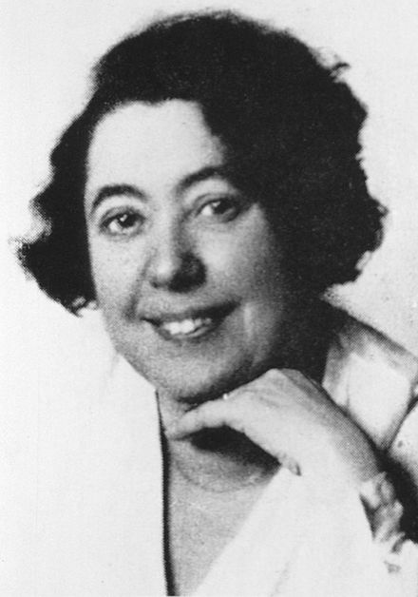
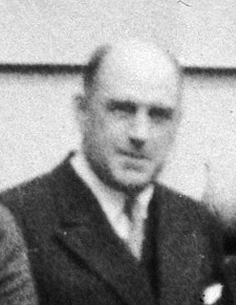
The origin of the term “blood-brain barrier”
Based on the results of these dye experiments, Lina Stern and Raymond Gautier proposed the term “blood-brain barrier” in 1918
Stern ( between ~1921-1934) went on to describe the physiological importance of this barrier, as well as its relevance in trauma
e.g., carbon monoxide poisoning lead to dyes entering the central nervous system
Lina Stern
Raymond Gautier (I think)

Slide 9
Sterns findings were ignored
The findings by Stern were ignored for twenty years, and it was widely thought the brain was protected by a impermeable membrane
1950-1980: The idea that peripheral molecules could enter the central nervous system was revisited
Certain radio-labelled amino acids injected into the circulatory system entered the brain
Electrophysiology techniques demonstrated ions crossed the from blood to brain

Slide 10
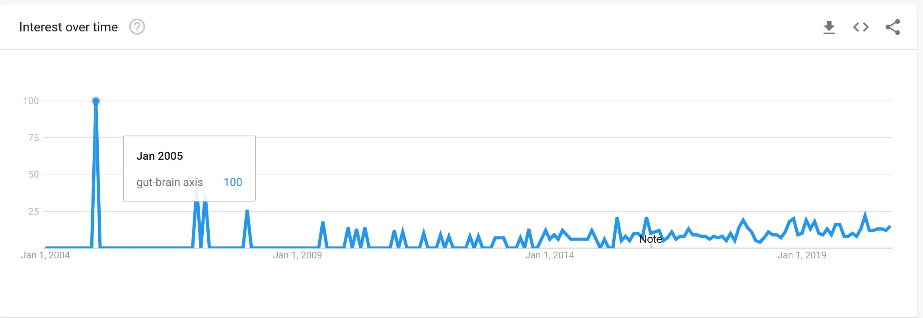
The gut-brain axis was first described in 2004
July 2004: Sudo et al. publishes an article describing the effects of gut microbes on brain function
January 2005: “Gut-brain axis” gets googled a lot

Slide 11
Take home messages
The brain is considered an immune-privileged organ because the immune system does not attack foreign tissues grafted to the brain
The term ‘blood-brain barrier’ was born from the discovery that membrane-impermeable dyes could not cross from blood-to-central nervous system
The concept of the gut-brain axis is very new (~15 years old), and a majority of research has been published in the last five years
Our understanding of the gut-brain axis could drastically change in the next 15 years

Slide 12
What is the blood-brain barrier (BBB)

Slide 13
What is the blood-brain barrier (BBB)?
A group of cells and proteins that allow specific molecules to cross from blood-to-brain, brain-to-blood, or both
The BBB is a highly selective semipermeable border

Slide 14
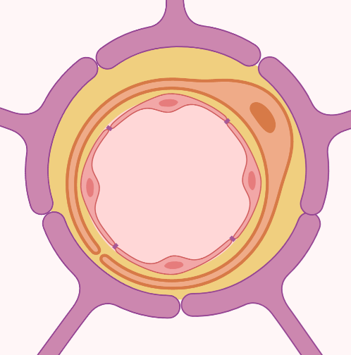
Cells and proteins that make up and maintain the BBB
Brain parenchyma (contains neurons and microglia)
Astrocytes
Endothelial cells
Pericytes
Astrocytes
Basement membrane (protein structure)
Leukocytes, microglia and neurons
Basement membrane
Pericyte
Blood (contains leukocytes)
Tight junction proteins
Endothelial cells
Created with biorender.io

Slide 15
Cells and proteins that make up and maintain the BBB
Endothelial cells
Pericytes
Astrocytes
Basement membrane (protein structure)
Leukocytes, microglia and neurons
Cells and proteins in red = structure & signaling
Cells highlighted = primarily influence signaling events that affect BBB permeability

Slide 16
Molecules readily cross the BBB until pericytes form
Endothelial cells
Pericytes – Permeability of the BBB is compromised until progenitor cells differentiate into pericytes (Daneman et al. 2010)
Astrocytes
Basement membrane (protein structure)
Leukocytes, microglia and neurons

Slide 17
The permeability of the BBB is not constant
Molecules can increase the permeability of the BBB, including
Endogenous molecules (e.g., cytokines, ATP, free radicals, histamines, thrombine, prostaglandin, etc.)
Microglia, leukocytes or neurons release the above molecules
Experimental intervention (e.g., hypertonic solutions)
Disease conditions can also affect the permeability of the BBB
Patients of Alzheimer’s disease exhibit reduced expression of BBB integrity markers, as well as increased concentrations of peripheral molecules

Slide 18
Mechanisms of blood-brain barrier (BBB) transport

Slide 19
Seven processes that mediate the transport of molecules across the BBB
Paracellular transport
Transcellular passive transport
Transmembrane protein-assisted transport
Efflux pump-mediated transport
Receptor-mediated transcytosis
Adsorptive transcytosis
Cell-mediated transcytosis

Slide 20
Overview of paracellular transport
Paracellular transport: Passive diffusion in between endothelial cells
Remember: Diffusion follows a concentration gradient, and passive denotes no energy input required
Prevented by tight junction proteins under physiological conditions
Paracellular transport can occur when endothelial membranes or tight junctions are disrupted
e.g., osmotic shock (hypertonic solutions)
Tight junction proteins
Created with biorender.io

Slide 21
Overview of transcellular passive transport
Passive diffusion of molecules through an endothelial cell
In general these molecules must have the following properties:
Small ( < 400 Da)
Nonpolar (lipophilic)
Uncharged
Most drugs that target brain tissues utilize this transport mechanism
Red arrows: possible direction of molecular movement
Created with biorender.io

Slide 22
Overview of transmembrane protein-assisted transport
Passive, transcellular diffusion utilizing a transport protein
e.g., glucose; large, neutral amino acids such as levodopa; excitatory amino acids such as glutamate; ketone bodies; nucleosides; short-chain fatty acids (produced by bacteria)
Note: While many molecules produced by bacteria use this form of transport, this may not be true for every molecule produced by microbes
Transmembrane transport proteins
Red arrows: possible direction of molecular movement
Created with biorender.io

Slide 23
Overview of efflux pump-mediated transport
Active transport
Requires energy input to move molecules against a concentration gradient
Usually transports charged lipophilic molecules (e.g., glutathione)
P-glycoprotein is an example of an efflux pump
Often prevents drugs from crossing endothelial membranes
Efflux protein pump
Red arrows: Direction of molecular movement
Created with biorender.io

Slide 24
Overview of receptor-mediated transcytosis
Transcytosis: Transport through a cell
Active transport of molecules through endothelial cells
Molecules bind to a receptor
Molecule-receptor complex gets engulfed by plasma membrane, forming an intracellular vesicle
The intracellular vesicle can either be sent to be degraded, or transported across the BBB
Molecules that utilize this transport include insulin and transferrin
Some drugs attempting to utilize this mechanism are in clinical trials
Vesicle degraded by lysosomes
Red arrows: possible direction of molecular movement
Created with biorender.io

Slide 25
Overview of adsorptive transcytosis
Active transport of positively charged molecules
Not a common mechanism, and very few positively charged molecules can utilize this transport method
Positively charged molecules bind to the negatively charged plasma membrane of endothelial cells
Molecules get engulfed, forming a vesicle that can be transported across the BBB
Important molecules described to engage this transport mechanism include histones and avidin
+
-
-
-
-
-
-
-
+
+
Red arrows: possible direction of molecular movement
Created with biorender.io
+

Slide 26
Overview of cell-mediated transcytosis
Active transport of immune cells across the BBB
Immune cells include monocytes, macrophages and neutrophils
This movement may be paracellular or transcellular – it is currently unclear
Drugs can be engulfed by these immune cells; these immune cells will release the drugs when they cross the BBB
Drugs are delivered to many places throughout the body (i.e., this process is not selective)
Molecule being transported
Immune cell
?
?
Red arrows: possible direction of molecular movement
Created with biorender.io

Slide 27
Take home messages
The BBB is a highly selective, semi permeable border
The primary structural components of the BBB include endothelial cells, pericytes, astrocytes, and the basement membrane
The permeability of the BBB can change
There exist seven (or six) mechanisms that allow molecules to cross the BBB
Transcellular passive transport and transmembrane protein-assisted transport are the most utilized
Many studies looking at gut microbes implicate trans membrane protein-assist transport

Slide 28
Introduction to the gut microbiota

Slide 29
Overview of the gut microbiota
Not all pathogens cause infections (in fact, many don’t)
Gut microbiota does not refer to infectious pathogens (e.g., S. aureus or toxic E. coli)
There exist a type of E. coli in the human gut, but they are not pathogenic
Human fetus grows in a sterile environment
Until the amniotic sac (membrane) ruptures, the fetus exists in a germ-free environment
i.e., gut microbiota is negligible until the amniotic sac ruptures
Gut microbes co-exist with humans in a mutualistic relationship
Microbes are necessary for synthesis of vitamin K and B
Involved in the metabolism of many compounds, such a bile acids, sterols, and drugs

Slide 30
Pathways that allow gut microbes to communicate with the brain

Slide 31
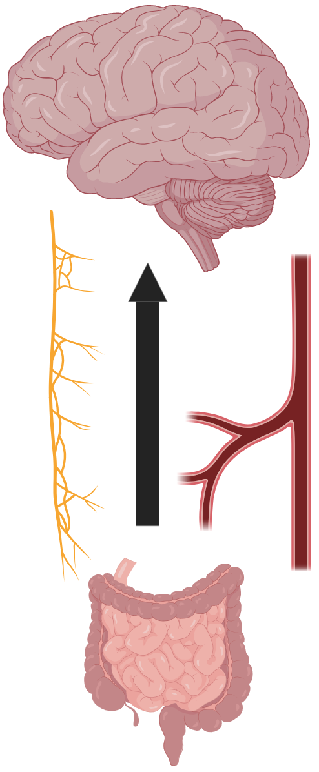
Note: that these bacterial metabolites must engage one of the mechanisms described in video 2 to cross the BBB!
Molecules produced by gut microbes (metabolites), such as short-chain fatty acids, can enter into the circulatory system, cross the BBB, and enter into the brain
Created with biorender.io

Slide 32
But what does this have to do with gut microbes?
Molecules, such the cytokine interleukin-1β, can activate afferent fibres of the vagus nerve, causing changes in the brain
This pathway is classically called the “inflammatory reflex”
e.g., Short-chain fatty acids can reduce release of interleukin-1β by cells, and thus help reduce the activation of the vagus nerve
Created with biorender.io

Slide 33
Consequences of an absent gut microbiota

Slide 34
What experimental conditions define an “absent gut microbiota”
A majority of our understanding about the gut microbiota has been obtained from experiments comparing mice with and without gut microbes
Mice without gut microbes are referred to as ‘germ-free’ mice
Birthed and housed in an isolation chamber which fully blocks exposure to microorganisms
Treated with antibiotics later in life
Mice with gut microbes are experimentally referred to a specific pathogen-free mice (control mice)

Slide 35
Neurodevelopmental consequences of an absent gut microbiota
Brain cells from germ-free mice born in an isolation chamber exhibit abnormal phenotypes (Erny et al. 2015)
Microglia (innate immune cells of the brain) exhibit a reduced response to immune stimuli
Possibly increases susceptibility to meningitis (bacterial infection in the brain)
The number of immature microglia is much higher in germ-free mice than specific pathogen-free mice
When germ-free mice are recolonized with a gut microbiota, the phenotype of microglia returns to normal

Slide 36
Note that the germ-free model can affect results
Recall: germ-free mice can be generated by being 1) birthed in an isolation chamber, or 2) exposed to antibiotics
Germ-free mice birthed in an isolation chamber have altered brain cell phenotypes
This may affect behavioral studies
‘Germ-free’ mice given many doses of antibiotics
Some bacteria may still be present
These bacteria could be antibiotic-resistant bacteria
Affect eukaryotic cells (e.g., immune cell responses)
What is the solution? There is none – and that’s OK! - just keep in mind the limitations of your experiments

Slide 37
Consequences of an abnormal gut microbiota

Slide 38
Gut microbiota affects the body composition of mice
Many studies have suggested that the composition of the gut microbiota affects body fat percentages
e.g., in cohort study of mice, there was an obese group of mice, and a lean group of mice
The microbiota of the lean mice was removed by antibiotic treatments
Fecal matter (contains gut microbes) from obese mice was transplanted into lean mice
Lean mice exposed to the fecal matter experienced statistically significant weight gain, despite no differences in caloric intake
The opposite observation was made when the obese mice were exposed to a fecal transplant from lean mice

Slide 39
Parkinson’s disease
Parkinson’s disease is a neurological disorder
Symptoms include impaired motor and cognitive function
A defining pathology of Parkinson’s diseases loss of dopamine-producing neurons in the midbrain
Specifically, a loss of neurons in the ‘substantia nigra’
Loss of dopamine is partially responsible for motor symptoms
Drugs used to treat PD lead to increased dopamine levels in the brain, temporarily alleviating motor symptoms
The other defining pathology of Parkinson’s diseases is clumps of a protein called α-synuclein
Clumps of α-synuclein are called Lewy bodies

Slide 40
Patients with Parkinson’s disease often exhibit gastrointestinal symptoms
A subset of patients with Parkinson’s disease exhibit gastrointestinal symptoms prior to motor and cognitive dysfunction
Prevalence of the gastrointestinal symptoms is so high that it has been referred to as the prodromal phase of PD (Bridi and Hirth, 2018)
Prodromal: Early sign or symptom (prior to clinical diagnostic signs) that indicates onset of disease

Slide 41
Previous studies suggest that α-synuclein created in the gut moves up the vagus nerve and deposits itself in brain tissue
α-synuclein may be a prion-like protein (Liu et al. 2017)
Lewy body deposits found in the gut of Parkinson’s disease patients
α-synuclein can move from cell-to-cell, as well as neuron-to-neuron, in a mouse model of Parkinson’s disease
Therefore, α-synuclein can move up the vagus nerve, and deposit itself in brain tissue
Humans sometimes undergo surgery to have their vagus nerve cut
Typically to reduce gastric secretions that cause peptic ulcers
Approximate site that vagus nerve innervates
Modified from Thal et al. 2004

Slide 42
Population studies show that humans with their vagus nerve cut have a lower incidence of Parkinson’s disease
Humans with their vagus nerve cut have a small, but statistically significant, reduction in the incidence of Parkinson’s disease (Liu et al. 2017)
This is not a treatment for Parkinson’s disease
The effect is small
To see this lower incidence of Parkinson’s disease in the real world – we would all have to have an elective surgery to cut our vagus nerve cut at an early age – NOT A GOOD IDEA
There are many side-effects of this surgery
This does make scientists interested in studying how the gut microbiota affects Parkinson’s disease

Slide 43
Limitations of experiments studying the gut microbiota
The gut microbiota of humans and mice are significantly different (Nguyen et al. 2015)
Clinical significance of observations in mice models still needs to be determined
There exist many phyla of bacteria in the human gut, and we do not yet understand the importance of each phyla
i.e., we do not yet know the function of each type of bacteria in the human gut
Maybe some are more useful than others

Slide 44
Limitations of experiments studying the gut microbiota
Many recently published studies demonstrate an association between the composition of the gut microbiota and neurological disorders, such as Parkinson’s disease (Scheperjans et al. 2015)
It is currently unknown whether diseases, such as Parkinson’s disease, initiate a change in the gut microbiota, or the progression of the disorder is regulated by changes in the gut microbiota
i.e., what came first – the disease or the gut microbiota changes?

Slide 45
Take home messages
An absent gut microbiota during development inhibits the normal growth of brain cells
Fecal transplant experiments suggest that gut microbiota can influence body composition of mice
Gastrointestinal symptoms occur in many Parkinson’s disease patients prior to clinical diagnostic symptoms
In a population study, humans undergone a vagotomy (the cutting of the vagus nerve) have a small, but statistically significant, reduction in the incidence of Parkinson’s disease
Many diseases are associated with changes in the composition of the gut microbiota; however, we do not know whether the disease came first, or the change in the microbial composition

